Slide 1

AskNow

Slide 2
Process
Finding the requirements
Create a basis
Link everything together to form one product
1
3
5
2
4
6
Studying the relevant material
Ellaborate on the basis
Come up with additional features

Slide 3
Features
Our key features that make our product stand out

Slide 4
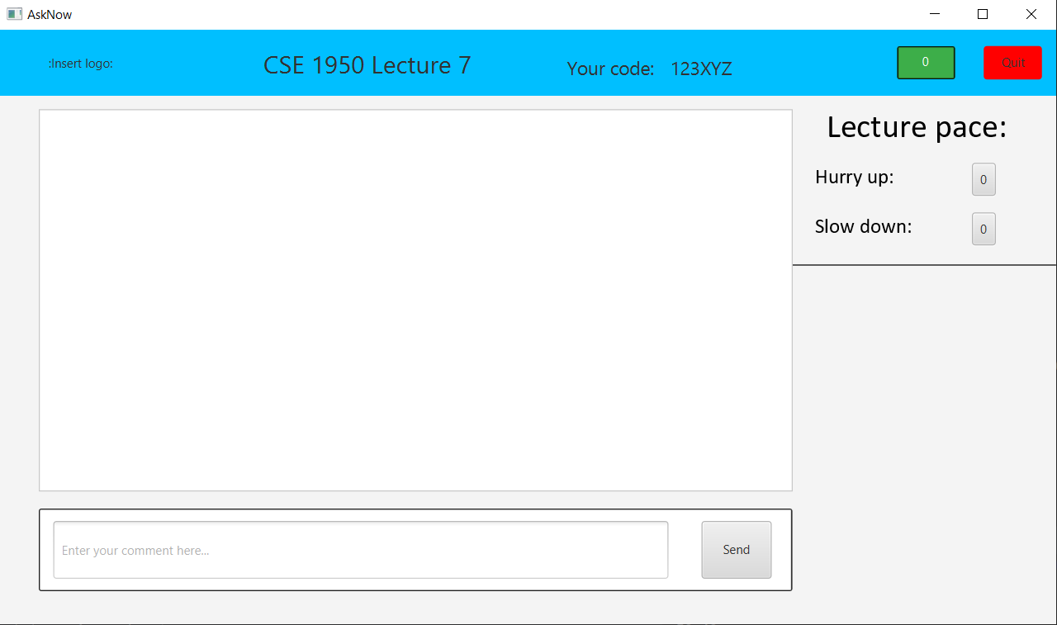
Our Project
Real-time communication with your lecturer. Ask what’s on your mind and give live feedback.

Slide 5

Roles
Roles have different codes
Code assigns the role of the user
48 billion unique codes

Slide 6

Instant feedback
Every student can ask a question to the lecturer in real time and upvote which question should be prioritized.

Slide 7
User-friendly UI
The simple and user-friendly UI makes it easy to navigate for both teachers/assistants and students. It’s main advantages being the appealing visual design with clear informational architecture.

Slide 8
Server-side security
All users’ actions are validated by the server
Users are uniquely identified by tokens server-generated at login
Roles are set per room
HTTPS over TLS can be easily patched in once certificates are obtained, leading to increased security.

Slide 9
Saved questions
At the end of every session, the questions and answers to the questions are saved as text files. Accessible at any time after the sessions has been closed.

Slide 10
Future Features!
Authentication
Courses
Video

Slide 11
Thanks!
Any questions?

Slide 13
Diagrams and infographics

